Slide 1
Accident Risk Prevention and Prediction Data Analytics Capstone Project
Atharva Kulkarni B 26
Siddhesh Marketkar B 32

Slide 2
Problem Statement
Given the challenges of public safety today, research and analysis of traffic and accident data to predict the risk of accidents is ubiquitous. Accident risk prediction can significantly improve public safety by warning the public.
In this project, the probability of accident risk for a given case with selected conditions is predicted. Features like weather, traffic volume, road conditions, time of the day, description of previous accidents are utilized from the dataset. With the help of few algorithms we will analyze various factors in order to reduce the accident risk prevention.

Slide 3
Literature Survey
Sr. No. | Author Name | Publisher and Year | Summary | Findings
1 | Sobhan Moosavi, Mohammad Hossein Samavatian | Cornell University, 2019 | By employing the US-Accidents dataset and through an extensive set of experiments across several large cities, we have evaluated our proposal against several baselines. Our analysis and results show significant improvements to predict rare accident events. the impact of traffic information, time, and points-of-interest data for real-time accident prediction | Paper is based on Heterogenous sparse data and real time prediction
2 | Roy C Park, Ellen Hong | Springer, August 2019 | They proposed mobile multimedia based service. This guide system can be used to provide a level of risk for each road segment and region but also to improve roads with recommendations, such as installation of safety features. In addition, it could support a mobile system that provides a driver with the optimized driving path for safety. | Proposing a end-to-end system for accident risk assessment.
3 | Jong-Deug Rye, Sangmin Park | The Journal of The Korea Institute of Intelligent Transport Systems 2018 | They have used Deep Learning based model in order to increase the predictive reliability. The purpose of this study is to compare the predictive performance of the negative binomial regression model and the deep learning method developed in this study to predict the frequency of traffic accidents in expressways | Deep Learning is used which is said to be more efficient than binomial regression models.

Slide 4
Tools
Windows
Programming Language
Python
Project Implementation
Jupyter Notebook
Tableau
Libraries
Numpy
Seaborn
Sklearn

Slide 5
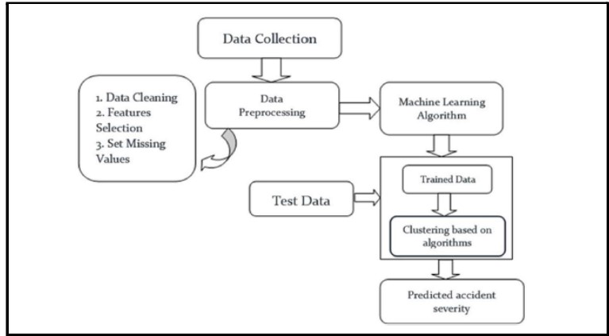
Design/Flow of the project
Tableau Link

Slide 6
THANK YOU!

